Slide 1


AGE 219: Data Analytics
& Scientific Plotting
Turning Big Data into Engineering Intelligence
Dr. Kadeghe Fue, PhD, P.Eng (T)
AI & Robotics Specialist | Office: EPAL | SoET SUA

Slide 2


Recap: Lecture 8 OOP
We mastered modeling machinery and biology as Objects (Classes), using attributes and behaviors to simulate farm systems.

Slide 3


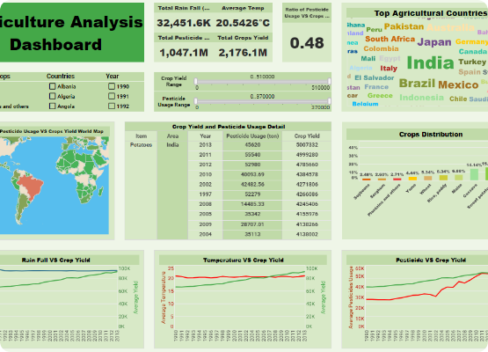
Data-Driven Agriculture
The Value of Analysis
Data is the "new fuel" for modern farming. Analytics allow engineers to move from guessing to precision.
By analyzing logs, we optimize fuel, minimize fertilizer waste, and predict crop maturity with high accuracy.

Slide 4
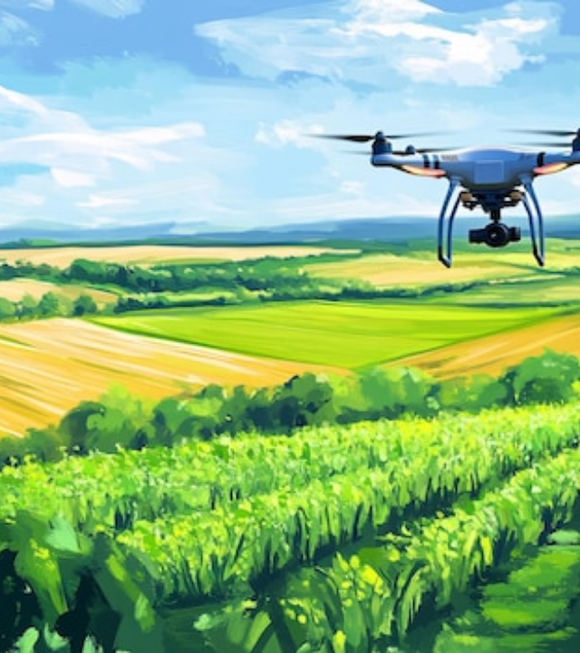
The Big Data Challenge
Field to Server
Modern farms generate massive sensor streams. Analyzing this "Big Data" requires specialized tools beyond simple Excel spreadsheets.
Python provides the industry standard "PyData Stack" to handle millions of records in milliseconds.

Slide 5






The PyData Stack
NumPy
Pandas
Matplotlib
Numerical Python. Foundation for all mathematical matrix operations.
Panel Data. High-performance, easy-to-use data structures (DataFrames).
The core plotting library for scientific and technical visualizations.

Slide 6
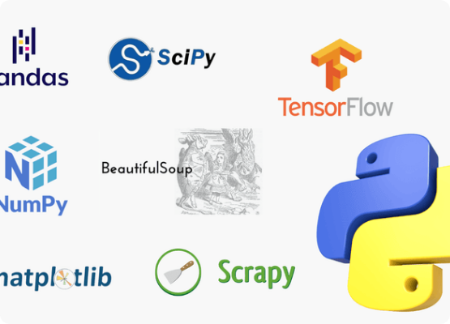
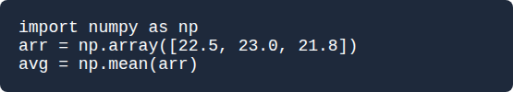
1. Introduction to NumPy
Matrices & Arrays
NumPy is built for speed. It allows us to perform "Vectorized" math (calculating 10,000 items at once) instead of using slow loops.

Slide 7

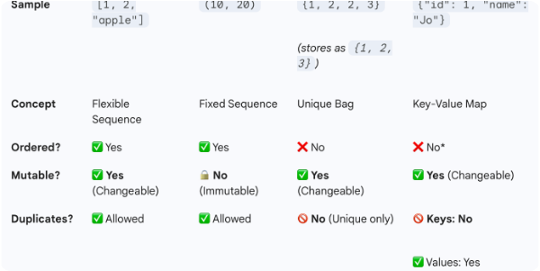
2. Pandas for Panel Data
The Powerhouse of Data Science.

Slide 8



Series vs. DataFrames
Pandas Series
Pandas DataFrame
A 1D labeled array. Think of it as a single Column from an Excel sheet or a sensor stream.
A 2D labeled data structure. This is the Whole Table (Rows and Columns), the core tool for analysis.

Slide 9

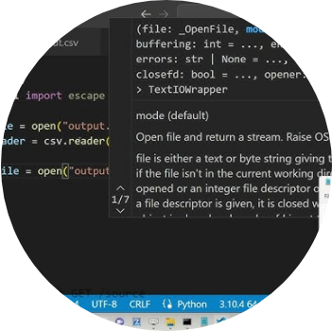
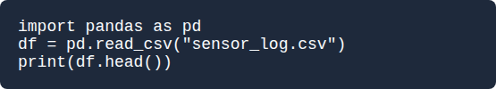
Loading CSV Data
One-Line Ingestion
Pandas makes loading sensor files trivial. It handles headers, dates, and types automatically.

Slide 10

Cleaning Messy Data
Dealing with NaNs
Field data often has gaps due to sensor failure or power loss (represented as NaN).
df.dropna(): Remove rows with gaps.
df.fillna(0): Replace gaps with a value.

Slide 11






Core Inspection Tools
.head()
.info()
.describe()
Shows the first 5 rows to verify loading.
Shows data types and memory usage.
Calculates count, mean, min, max instantly.

Slide 12


Statistical Calculation
x̄
Vectorized Stats
Arithmetic Mean
In Pandas: df['Yield'].mean(). Python calculates this for millions of rows in a heartbeat.

Slide 13
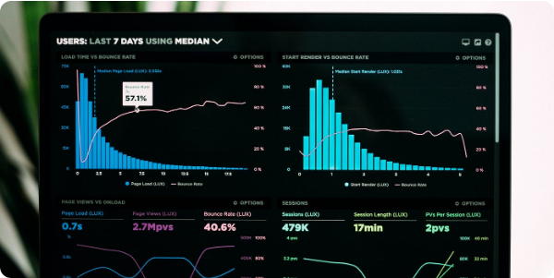
3. Scientific Visualization
Plotting Trends and Correlations.

Slide 14
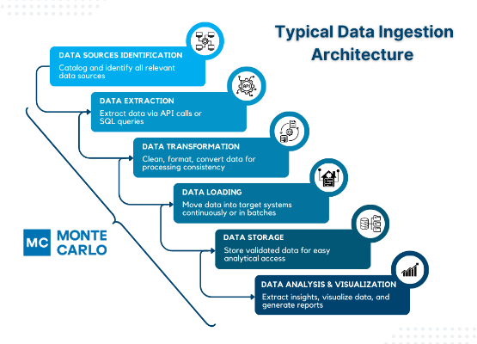
Why Matplotlib?
Publication Quality
Engineers need professional plots for reports and peer-reviewed papers. Matplotlib is the industry standard plotting engine.
Complete control over style.
Export to PDF/PNG.

Slide 15
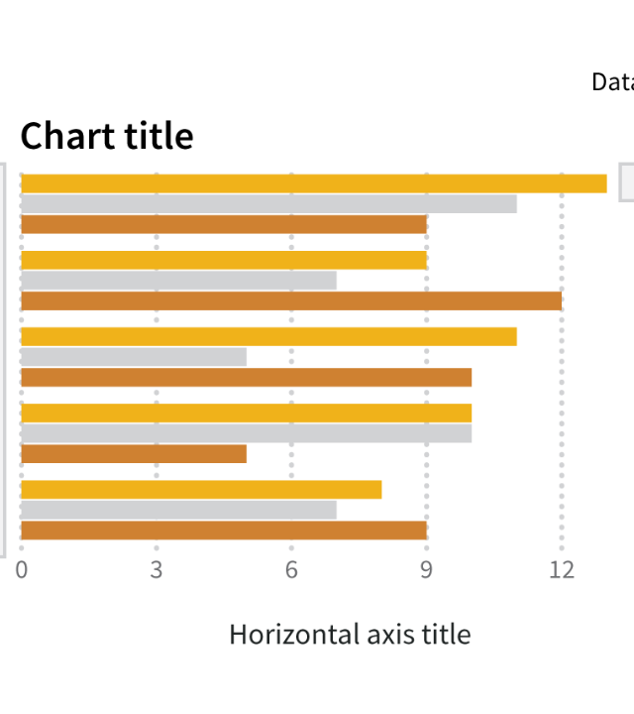
Anatomy of a Plot
Standard Components
Every scientific plot must have:
Y-Axis: The dependent variable.
X-Axis: Time or independent variable.
Labels: Units (e.g., °C, kg/ha).
Legend: Identifying data series.

Slide 16
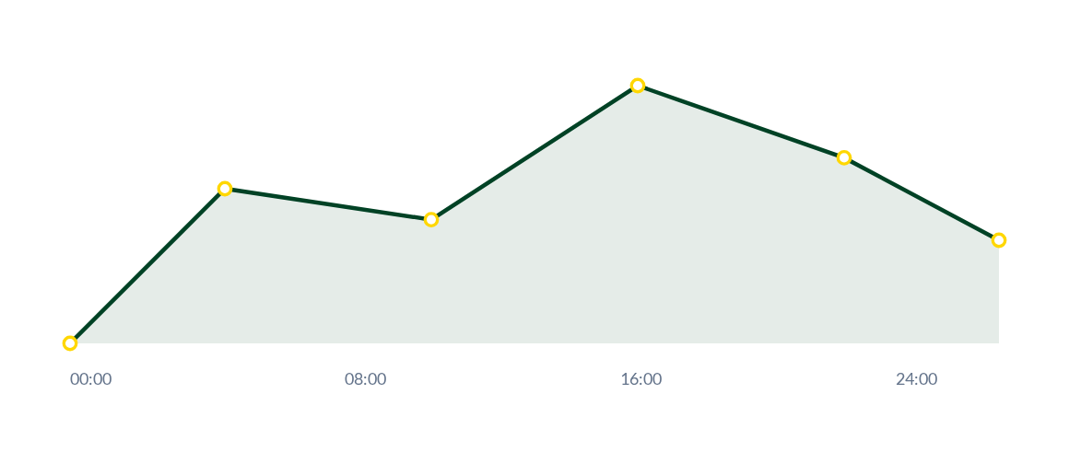
Line Plots: Temp Trends
Line charts are best for Time Series, showing how variables like soil moisture or temperature change over a season.

Slide 17
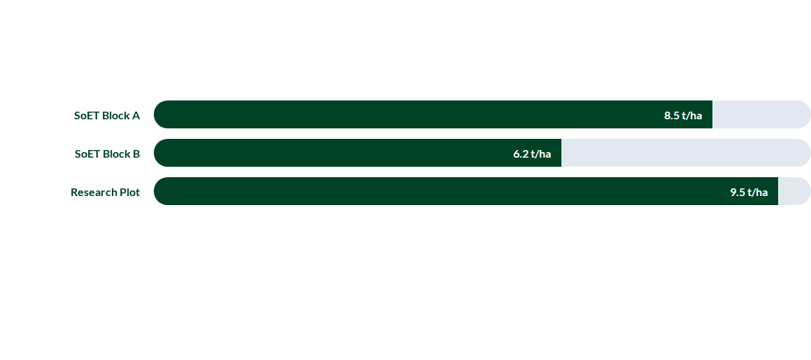
Bar Charts: Yield by Block
Bar charts are optimal for comparing Categorical Data across different farm plots or treatments.

Slide 18
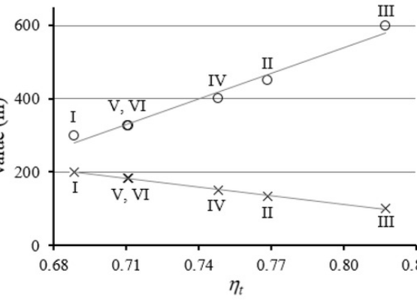
Scatter Plots: Correlation
Engine Efficiency
We use Scatter plots to find relationships between two continuous variables (e.g., Engine RPM vs. Fuel Flow).
Clusters or lines in the dots indicate strong correlations that help in machine tuning.

Slide 19
Plot Type Selection Guide
Requirement | Plot Type | Example Data
Show trends over time | Line Plot | Daily Rainfall (mm)
Compare categories | Bar Chart | Variety Harvest Yield
Relationship between vars | Scatter Plot | RPM vs. Torque
Show proportions | Doughnut | Farm Land Usage %

Slide 20
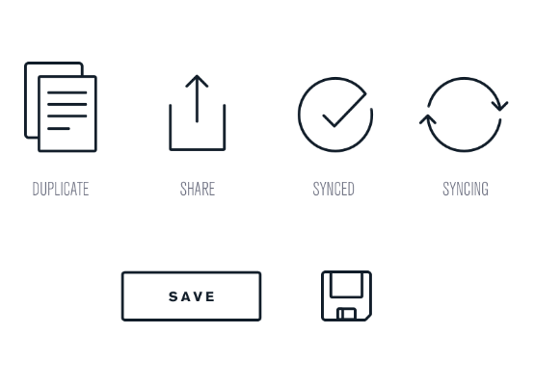
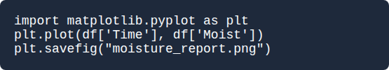
Exporting and Saving
Closing the Loop
Visualizations are only useful if they can be shared.

Slide 21
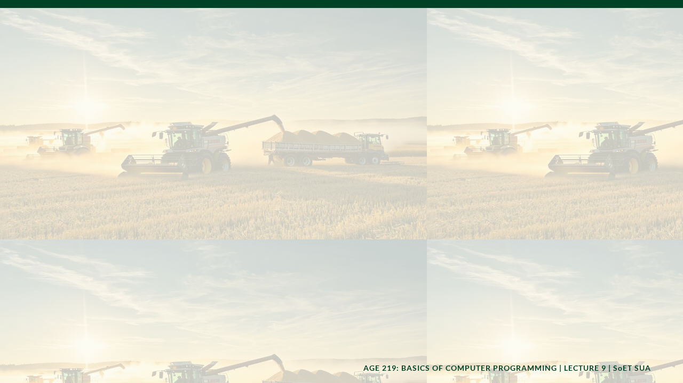
Case Study: Tanzania Yield Harvest
Integrating Lecture 7 (Files), Lecture 8 (OOP), and Lecture 9 (Analytics) to analyze the 2026 Maize performance at the Model Farm.

Slide 22


Questions?
Thank you for your attention.
Next Lecture: Capstone Integrated System Project
School of Engineering and Technology (SoET) | Office: EPAL

